Slide 1


Název školy | Hotelová škola Mariánské Lázně
Adresa školy | Komenského 449/2, 353 01 Mariánské Lázně
Číslo projektu | CZ.1.07/1.5.00/34.0970
Číslo DUMu | VY_32_INOVACE_G-AJ-12
Předmět | Anglický jazyk
Téma | British Christmas
Autor | Mgr. Lenka Voňavková
Metodický popis (anotace) | Prezentace o tradičních Vánocích ve Velké Británii, symbolech a zvycích s nimi spojenými.
Tento program je spolufinancovaný Evropským sociálním fondem a státním rozpočtem České republiky.

Slide 2
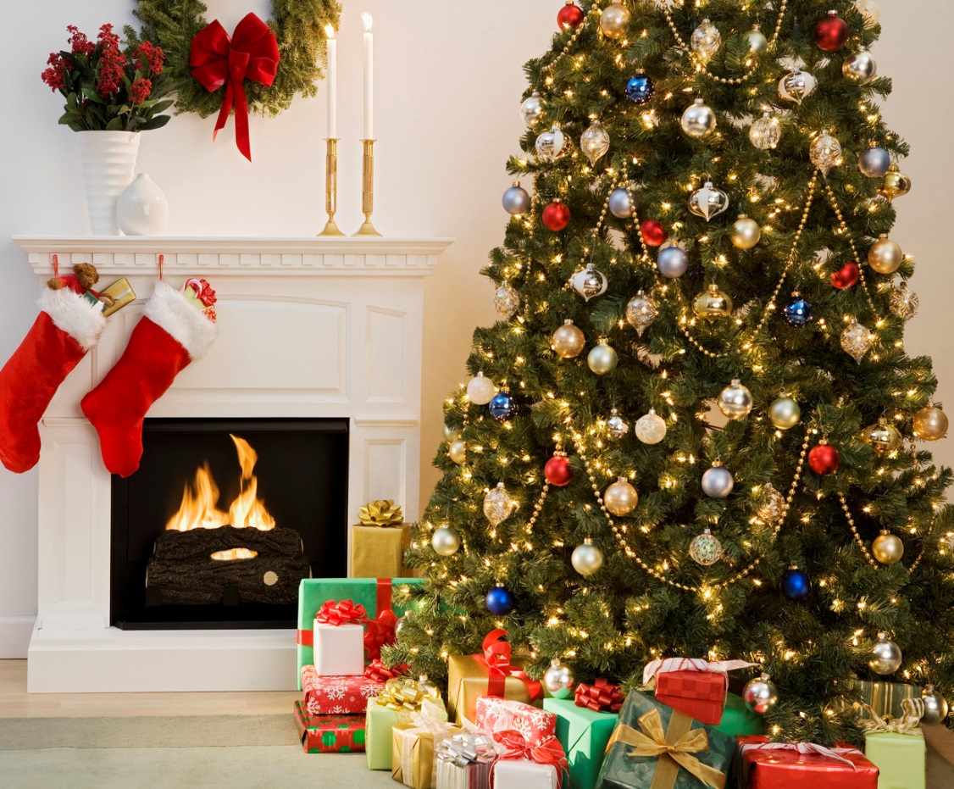
BRITISH CHRISTMAS

Slide 3
CHRISTMAS
also known as
Nativity
Noel
Xmas

Slide 4
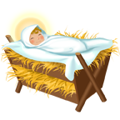
Why do people celebrate Christmas?
REMEMBER
They commemorate the birth of Jesus Christ.
What is Advent?
the four-week period before Christmas
a season of preparation for Christmas

Slide 5
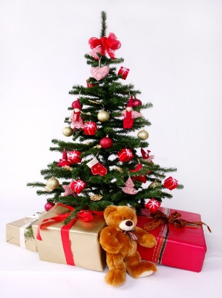
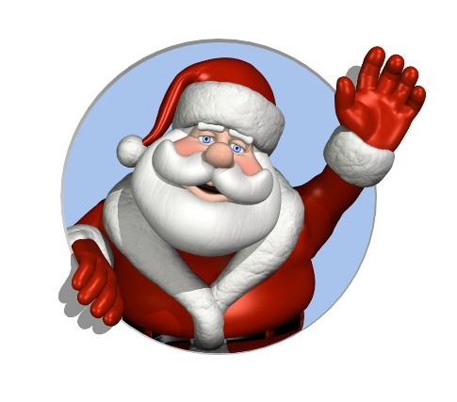
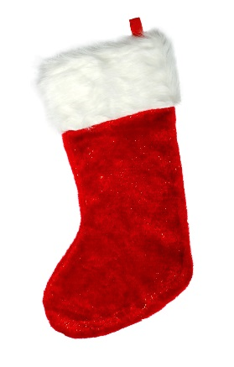

Symbols
Christmas tree
Father Christmas
Christmas stocking
reindeer

Slide 6
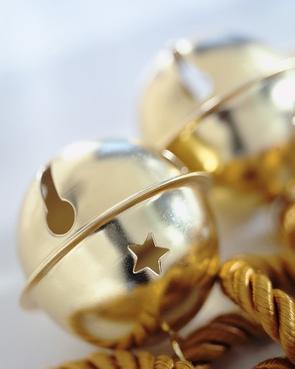

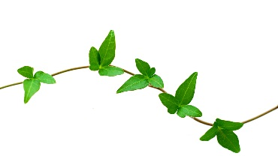

Symbols
jingle bells
holly
ivy
mistletoe
nativity
scene

Slide 7
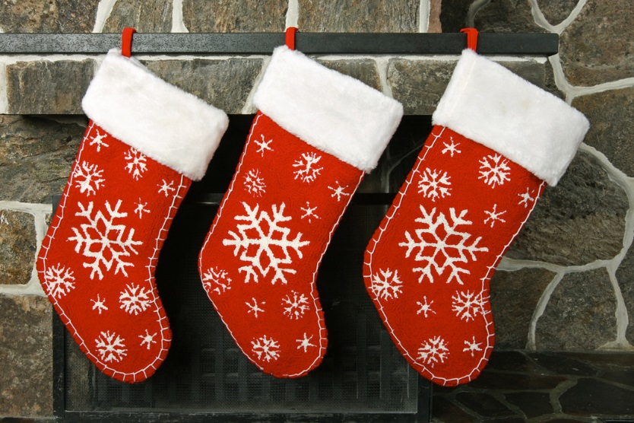
Christmas Eve (24th December )
The day is often reserved for the “office parties”.
Before going to bed children hang up their Christmas stockings at the fireplace or their beds.
They traditionally leave mince pies (sweets made of flour, dried fruit and nuts) and a glass of milk for Father Christmas and a carrot for his reindeer.

Slide 8
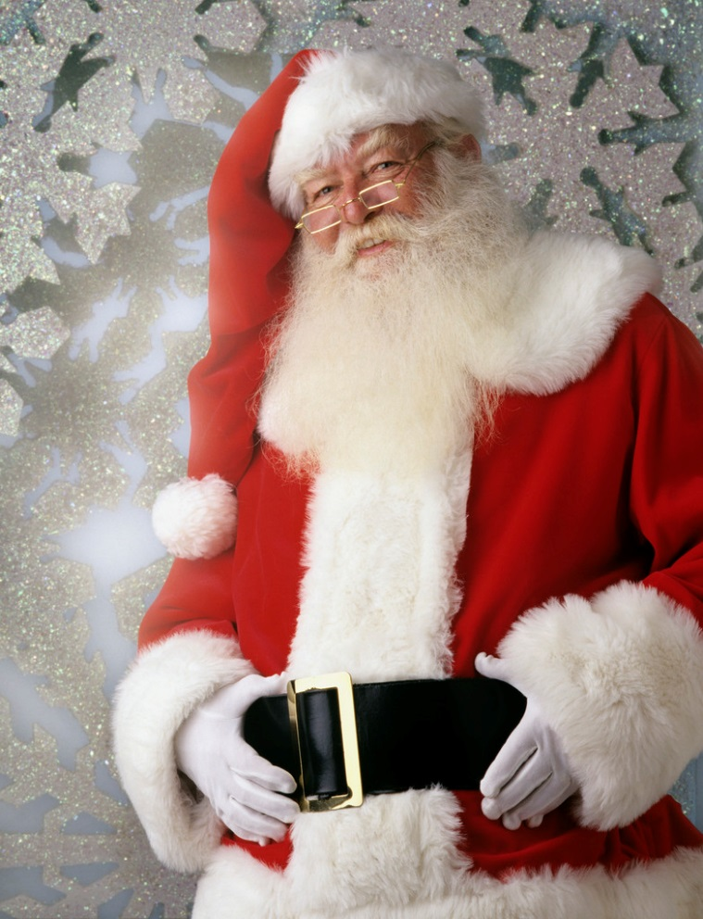
Father Christmas
an old large, joyous man with white beard, sometimes with glasses
wears a red coat and a hat with white fur, a black leather belt and boots
carries a large bag with presents
It is said he lives at the North Pole.

Slide 9
Father Christmas
rides through the air on a sledge drawn by reindeers
comes down the chimney
fills up the stockings with small presents and sweets and puts larger presents under the Christmas tree

Slide 10
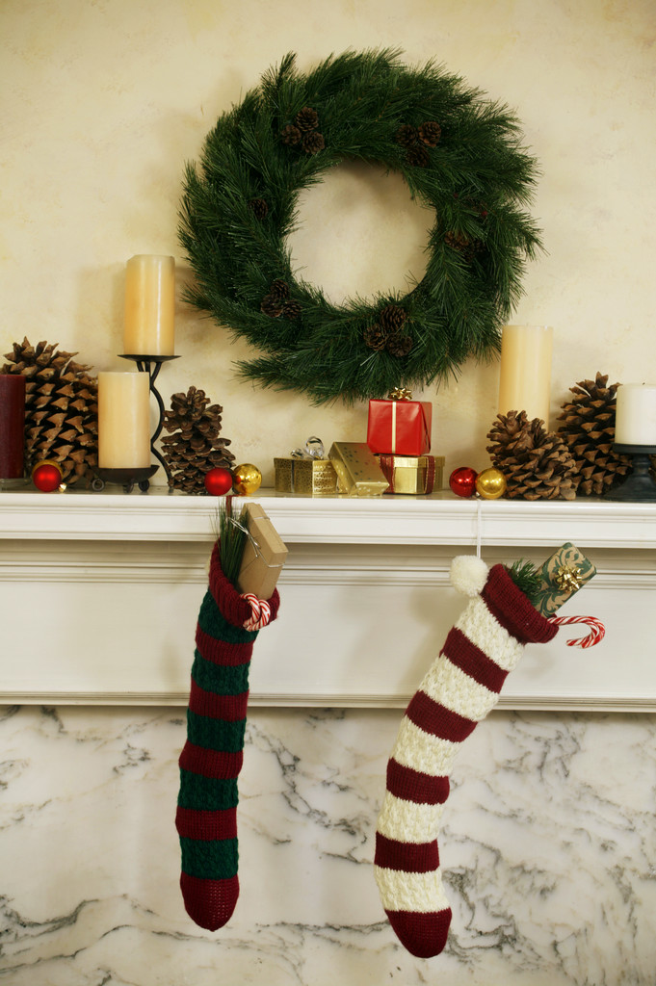
Christmas Day (25th December )
the most festive day
In the morning children wake up and find their stockings full of small gifts. They unwrap the presents.

Slide 11
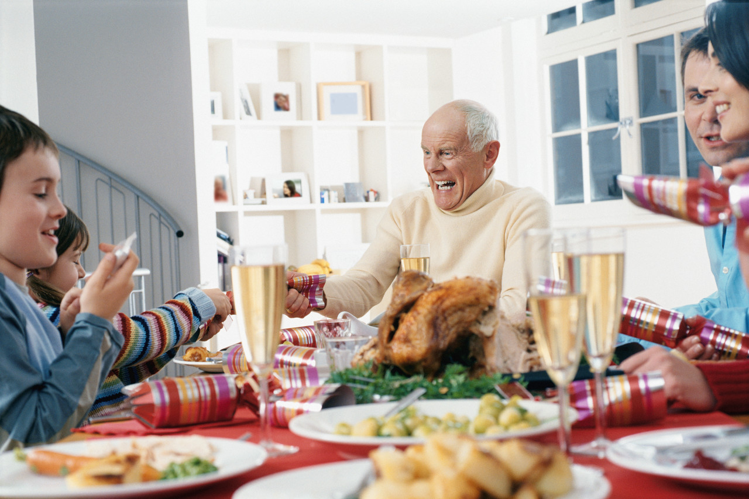
Christmas Day (25th December )
At midday or in the afternoon there is a Christmas dinner.

Slide 12
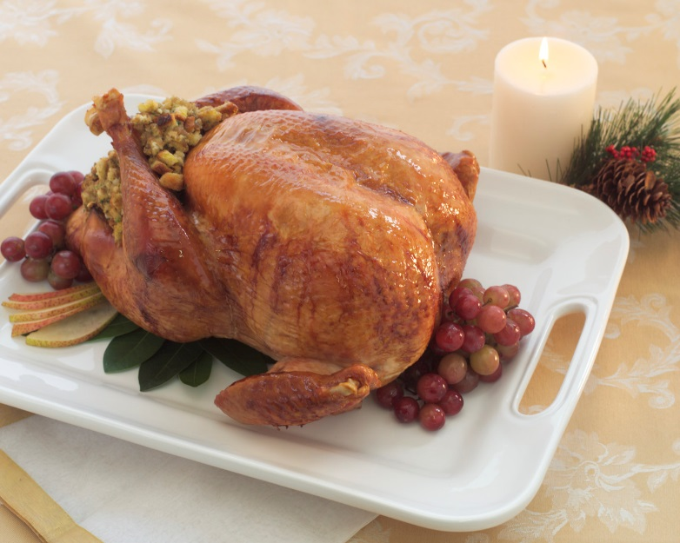
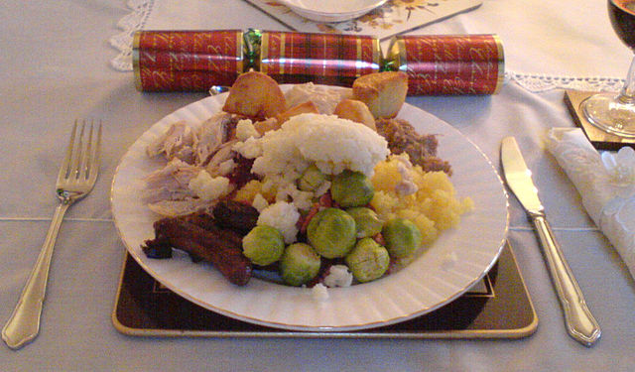
Christmas meal
The traditional meal is roast turkey with chestnut stuffing, vegetables (usually boiled Brussels sprouts and parsnip), roast potatoes and gravy.

Slide 13
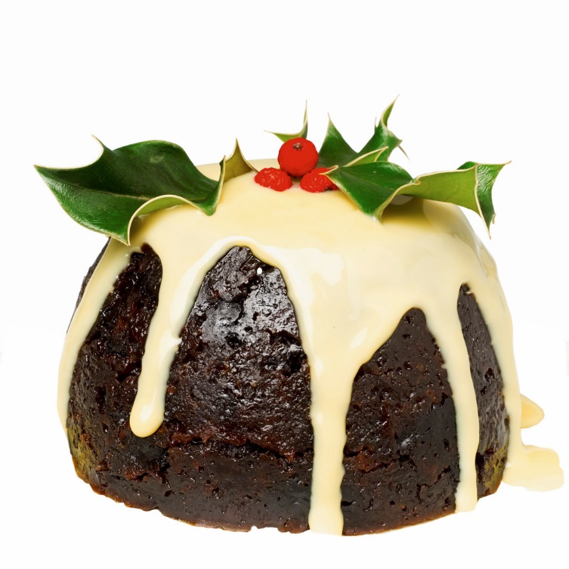
Christmas meal
Christmas pudding is a typical dessert.
It is a special heavy pudding made with dried fruit, eggs, suet and very little flour, flavoured with cinnamon, nutmeg, cloves, ginger and other spices.
  It is made in advance, boiled for hours and heated again on Christmas Day.
  It is covered in alcohol and before serving it is lit.
  It is often eaten with cream and brandy butter – a sweet sauce of sugar, butter and brandy.

Slide 14
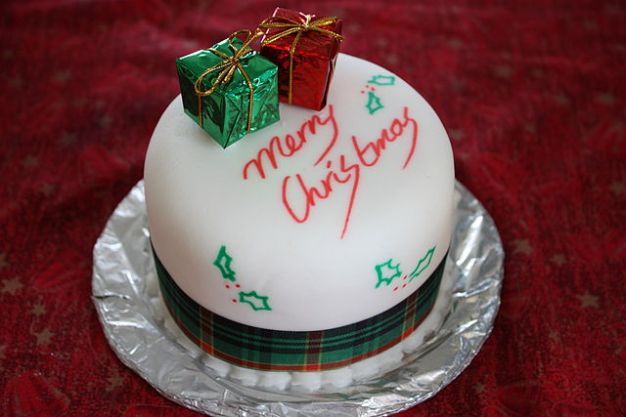
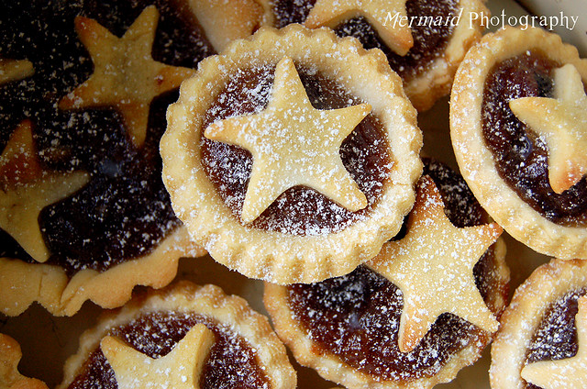
Christmas meal
At teatime they normally serve
fruit cake with marzipan
or
mince pies.

Slide 15
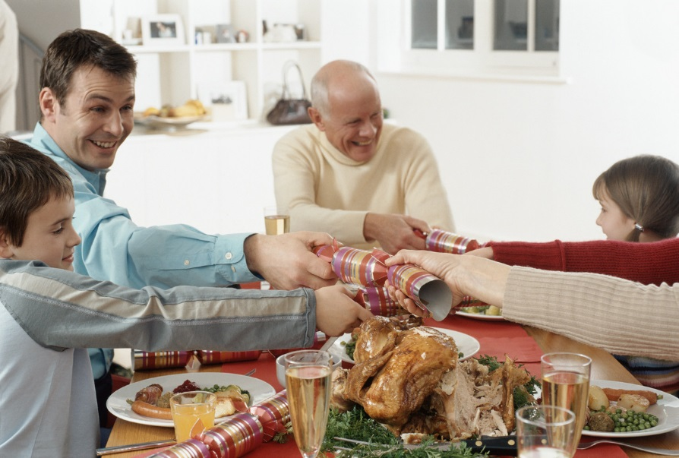
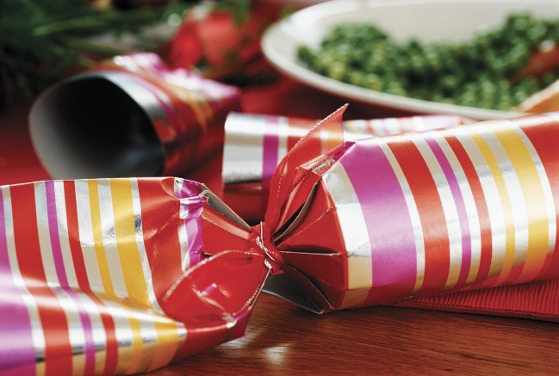
Christmas customs
Before Christmas dinner they open Christmas crackers
  cardboard tubes wrapped as a bonbon which is pulled by two people
  It makes a noise like a firecracker.
  Inside there is a silly gift, a party hat and a Christmas joke.

Slide 16
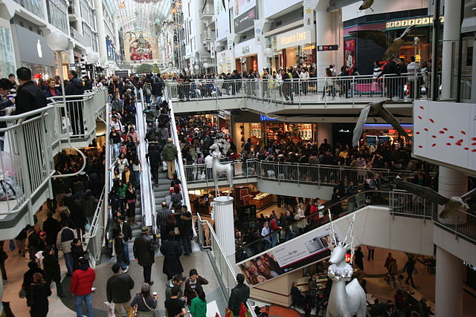
Boxing Day (26th December )
another bank holiday
In the past it was a day of giving money and other gifts to poor people and servants into „Christmas boxes“.
Nowadays it is a day to relax and to visit family and friends.
It is also known as a shopping holiday when shops have huge sales.

Slide 17
Obrázky a zdroje:
Klipart Microsoft Office
AUTOR NEUVEDEN. Wikipedia [online]. [cit. 18.1.2014]. Dostupný na WWW: http://en.wikipedia.org/wiki/File:ChristmasDinnerScotland.jpg
SMC. Wikipedia [online]. [cit. 25.1.2014]. Dostupný na WWW: http://en.wikipedia.org/wiki/File:Christmas_cake,_Boxing_Day_2008.jpg
MELBOURNE MERMAID. Flickr [online]. [cit. 25.1.2014]. Dostupný na WWW: http://www.flickr.com/photos/melbournemermaid/4218582012/sizes/z/in/photostream/
AUTOR NEUVEDEN. Wikipedia [online]. [cit. 25.1.2014]. Dostupný na WWW: http://en.wikipedia.org/wiki/File:Boxing_Day_at_the_Toronto_Eaton_Centre.jpg
„Materiál je určen pro bezplatné používání pro potřeby výuky a vzdělávání na všech typech škol a školských zařízení. Jakékoliv další využití podléhá autorskému zákonu. Veškerá vlastní díla autora (fotografie, videa) lze bezplatně dále používat i šířit při uvedení autorova jména.“

